Slide 1





SUPERVISOR
PROF. KOMAL SALGOTRA
MAJOR PROJECT (KCA 451)
EVEN SEMESTER
SESSION 2024-25
IMAGINIFY
TEAM LEADER- DARREN JAMES
2300290140050
TEAM MEMBERS
BHARGAVI - 2300290140048
DIVYANSH SHARMA - 2300290140057
ANSHOO YADAV - 2300290140028

Slide 2




Introduction
1
Introduction
Objective: To provide an AI-powered SaaS platform that simplifies advanced image editing tasks, allowing users to restore, modify, and enhance images effortlessly with automation and AI-based tools.
Significance: Reduces time and effort in image editing for both professionals and non-experts.
Enhances creativity and productivity by offering easy access to complex image manipulation features.
Helps content creators, designers, and businesses deliver high-quality visuals quickly.
Key Features: Object Removal, Background Removal, Image Restoration, Aspect Ratio Adjustment, Generative Fill, Object recoloring.
Application: E-commerce, Social media content enhancement, Graphic design and digital art.

Slide 3
Literature Review
2
The rapid rise of AI has transformed image processing by automating tasks like image restoration, object removal, and background replacement, these tools generate realistic results with minimal effort, enhancing efficiency and visual quality. Generative fill allows seamless image resizing, while AI-based segmentation outperforms traditional methods for background removal.
Cloud-based AI ensures scalability and smooth performance, making SaaS platforms popular for accessibility and affordability. With Stripe integration and a subscription model, they offer continuous updates, support, and reliable revenue

Slide 4

Objectives
3
OBJECTIVES
1
Simplify Advanced Image Editing
2
Enhance Visual Content Quality
3
Save Time and Boost Productivity

Slide 5
Technologies
4
Technologies
Frontend
Backend
Next.js
TypeScript
Tailwind CSS
Shadcn
Node.js
Cloudinary
MongoDB
Clerk

Slide 6
Modules
5
1. Authentication and User Management
Powered by Clerk for secure sign-ups, logins, and user management
Role-based access control (admin, user, etc.)
Profile management.
2.Image Processing Module (AI Core)
Image Restoration: Restore and enhance old or damaged photos.
Generative Fill: Extend image dimen-sions and adjust aspect ratio.
Object Removal: Remove unwanted objects with AI-based precision.
Object Recoloring: Change object colors with accurate detection.
Background Removal: Extract or replace image backgrounds.

Slide 7
Modules
6
3. Image Management and Storage
Cloudinary integration for image storage and processing
Upload, preview, and manage images in the user dashboard
Automatic optimization for fast loading
4.Dashboard and Payment Gateway
User-friendly dashboard for managing projects and tracking progress
Payment Gateway for purchasing credits to utilize the services of the application through stripe.
Download history and project organization tools

Slide 8
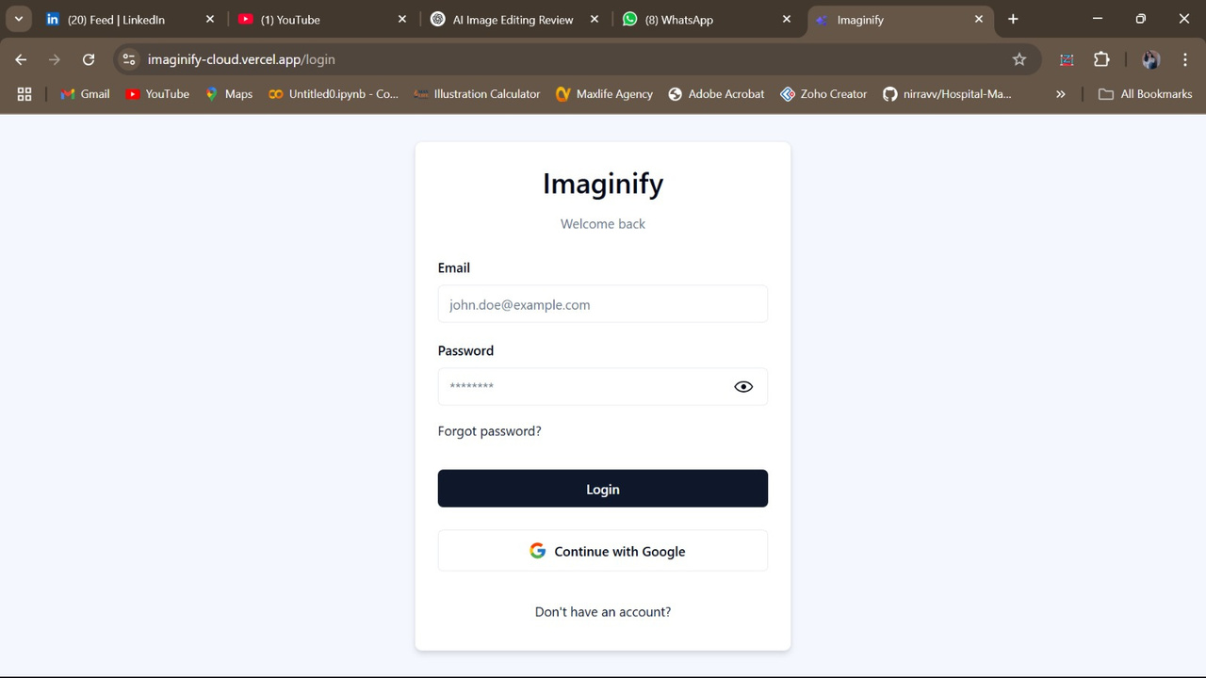
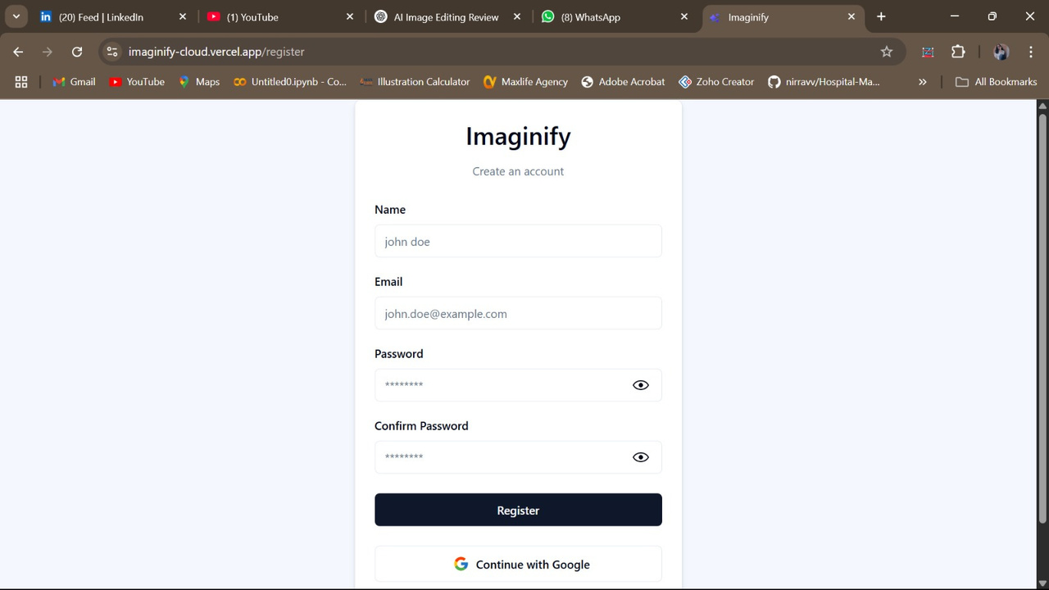
8
LOGIN/SIGNUP

Slide 9
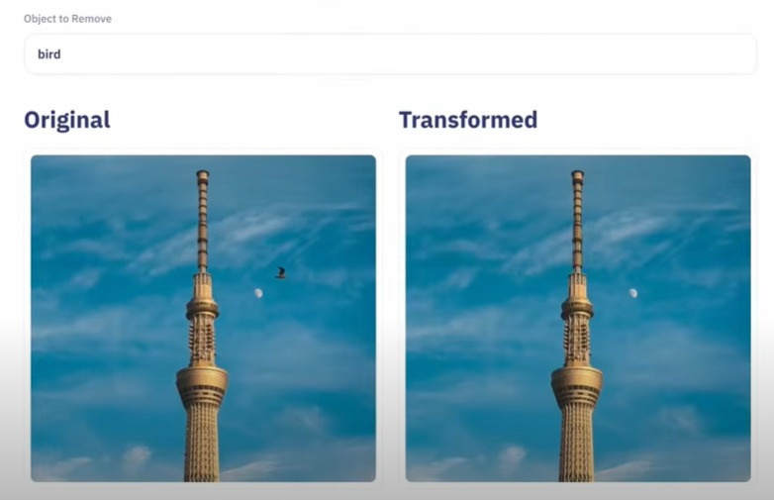
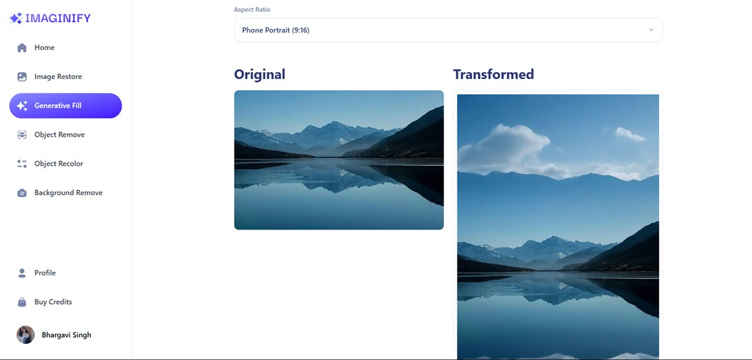
7
AI Object Removal:
Clean up images by removing unwanted objects with precision.
Image Generative Fill
Fill in missing areas of images seamlessly

Slide 10
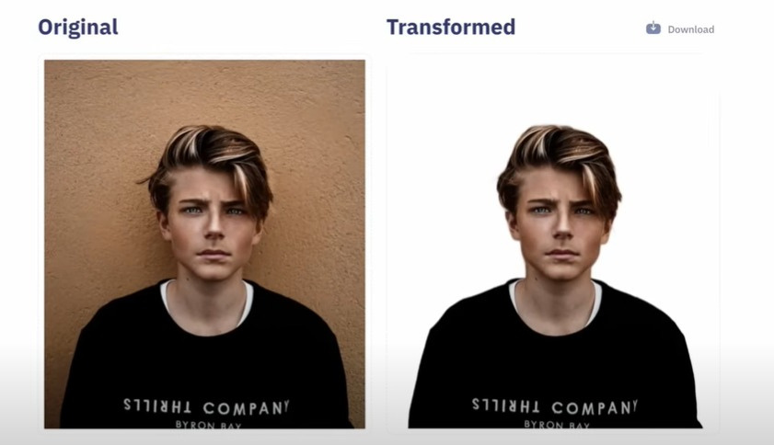
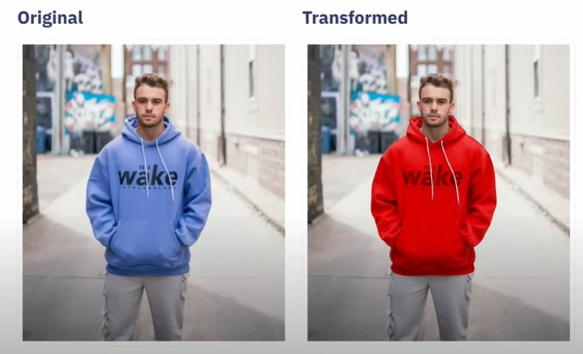
8
Background Removal:
Extract objects from backgrounds with ease
Image Recoloring:
Customize images by replacing objects with desired colors easily

Slide 11
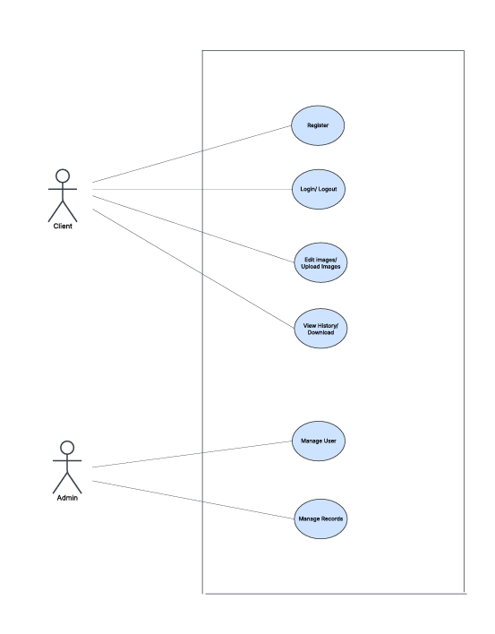
USE CASE DIAGRAM
9

Slide 12
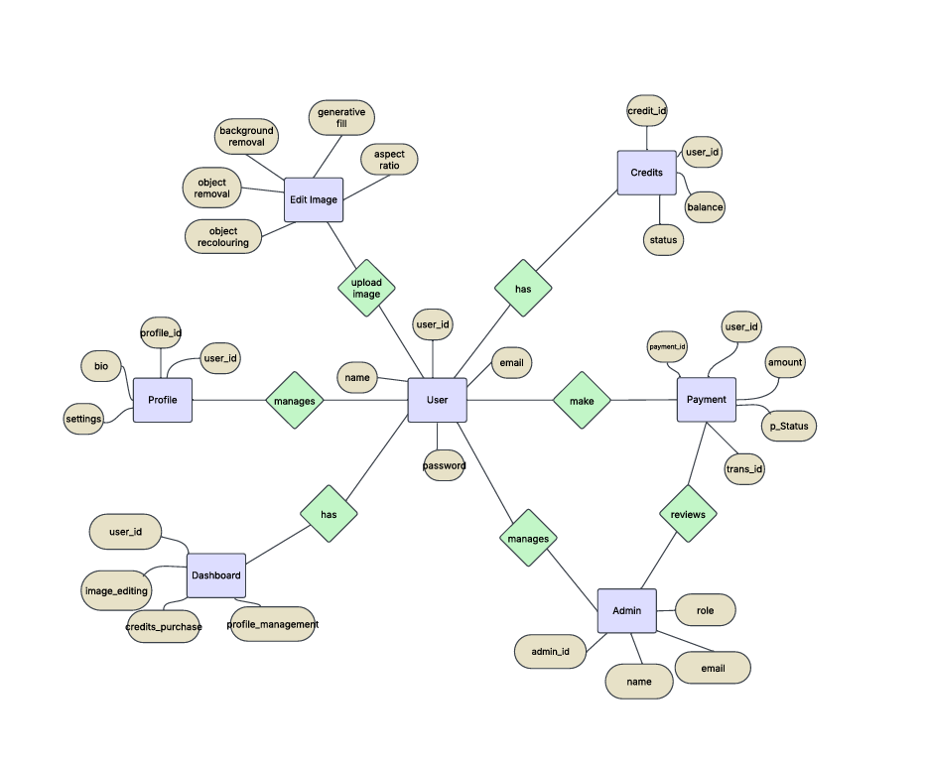
E-R DIAGRAM
10

Slide 13
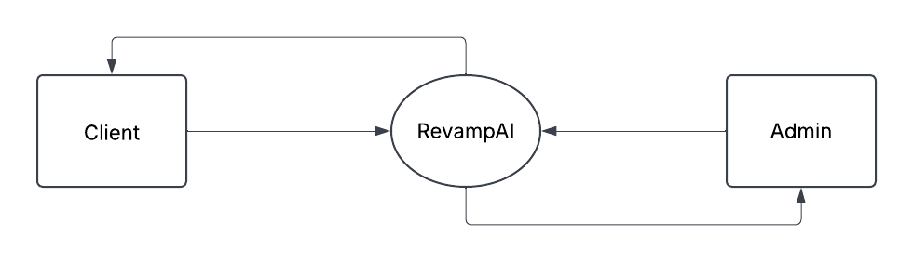
DATA FLOW DIAGRAM LEVEL-0
11

Slide 14
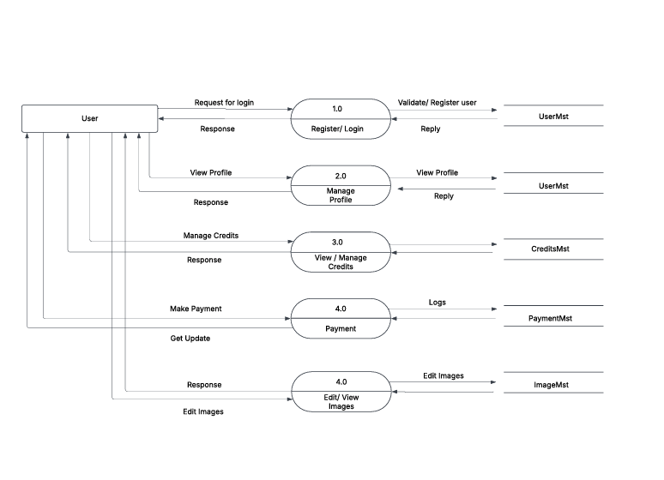
DATA FLOW DIAGRAM LEVEL-1 USER SIDE
12

Slide 15
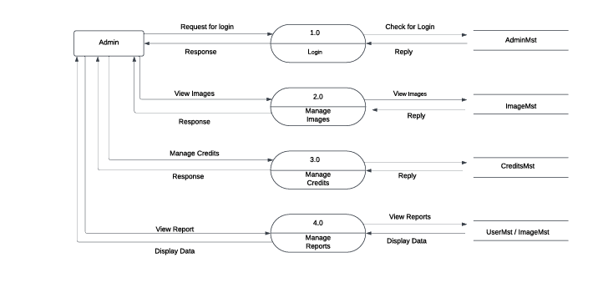
DATA FLOW DIAGRAM LEVEL-1 ADMIN SIDE
13

Slide 16
References
14
References
1. Kleppmann, M. (2017). Designing Data-Intensive Applications: The Big Ideas Behind Reliable, Scalable, and Maintainable Systems. O'Reilly Media, Inc
2. Next.js Documentation. (2024). Retrieved from [https://nextjs.org/docs](https://nextjs.org/docs)
Official documentation for Next.js, providing details on how to leverage the framework for building performant and scalable web applications.
3.Cloudinary Documentation. (2023). Retrieved from [https://cloudinary.com/documentation](https://cloudinary.com/documentation)
4. Stripe Documentation. (2023). Retrieved from [https://stripe.com/docs](https://stripe.com/docs)
5. Clerk Authentication Documentation. (2024). Retrieved from [https://clerk.dev/docs](https://clerk.dev/docs)

Slide 17

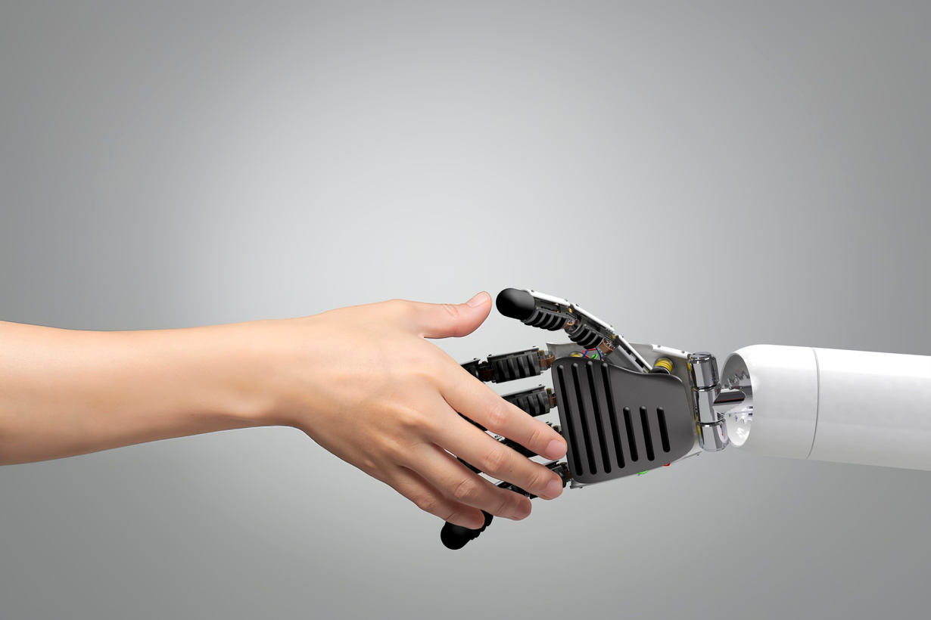
THANK YOU

